Slide 1


R Syntax 1: Data Types and Strings
Pilsung Kang
School of Industrial Management Engineering
Korea University

Slide 2
AGENDA
01
Handling Different Data Types
02
String Processing

Slide 3
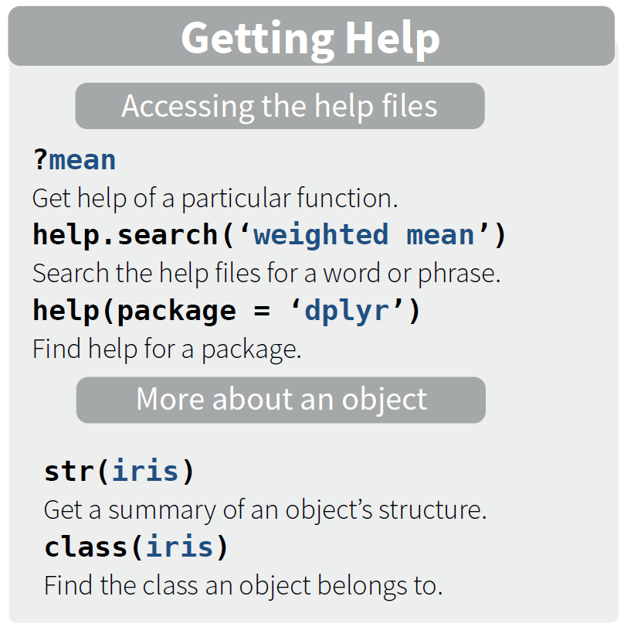
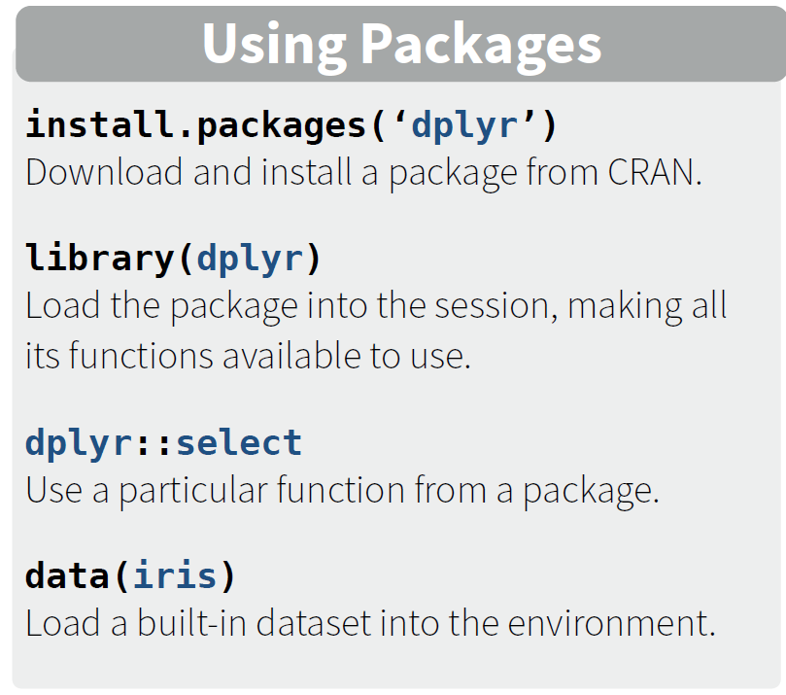
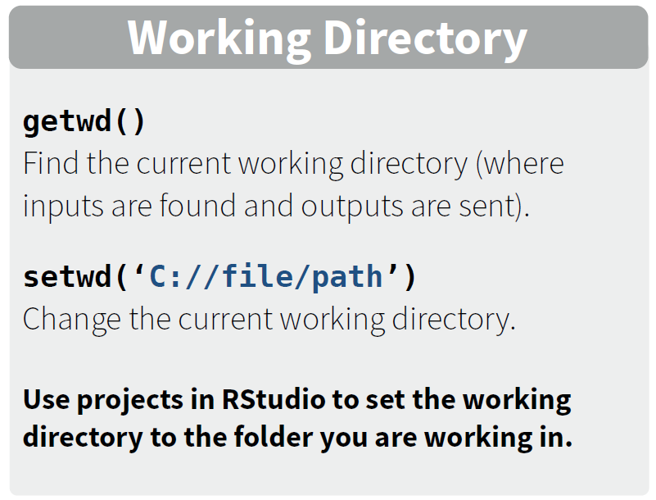
Basic Instructions
Getting Help, Using Packages, and Working Directory

Slide 4
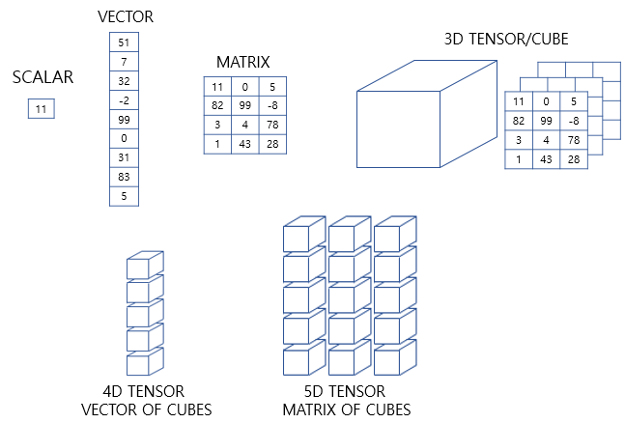
Data Types in R
Data Types w.r.t. dimensions
https://wikidocs.net/37001

Slide 5

Data Types in R
Tensor in Data Analytics
Whose eye is it?

Slide 6

Data Types in R
Tensor in Data Analytics
Whose eye is it?
It's my eye

Slide 7

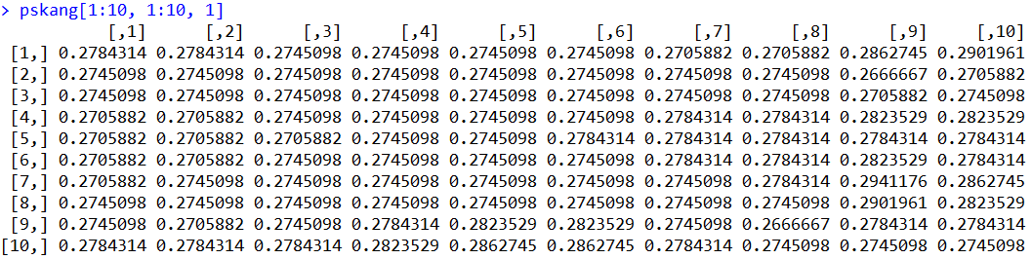
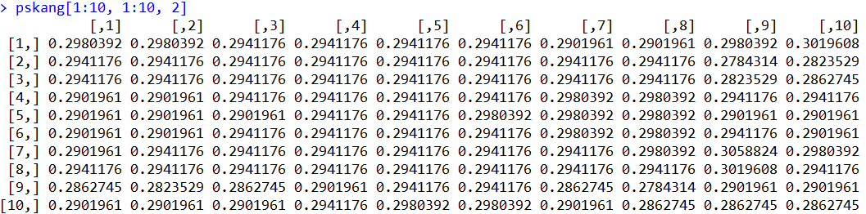
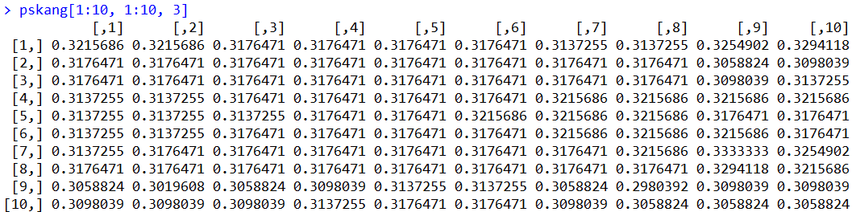
Data Types in R
Computers recognize an image as a 3-D Tensor: Width X Height X 3 (RGB)
1,685
2,247

Slide 8
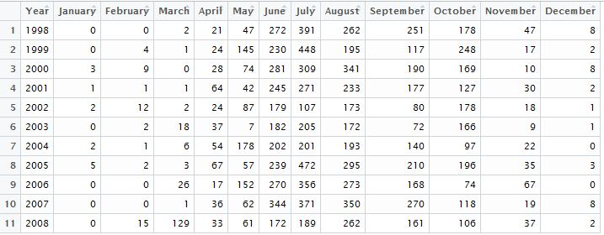
Data Types in R
Variable types
Homogeneous variables
All elements are the same type: numeric values in this example

Slide 9
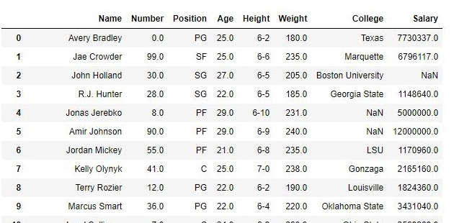
Data Types in R
Variable types
Homogeneous variables
Variables (Columns) are different types

Slide 10
Data Types in R
Questions
Q1: Are all variables homogeneous?
Q2: Are there more than one record?
Dataframe makes R powerful to analyze heterogeneous multivariate data
Attribute\No. Records | 1 | >= 2
Homogeneous | Vector | Matrix or Array
Heterogeneous | List | Dataframe

Slide 11
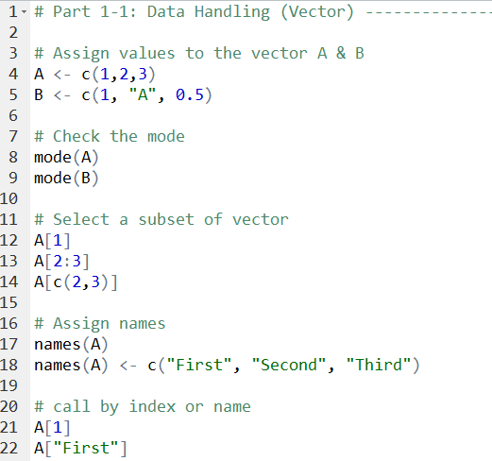
Data Types in R
Scalar
Vector
List
Matrix
Array
Factor
Data.frame
Vector
Vectors are homogeneous
All elements in a vector should be the same mode
Vector has an index for each element
A set of indices returns the corresponding sub-vector
Index starts from 1 (python: 0)
The elements of a vector can have its own name
Vectors in R is a column-wise vectors

Slide 12
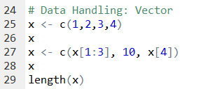
Handling Vectors
Vector initiation
Do not have to initiate → creation and value assignment are done at the same time
a <- 3: create a vector named ‘a’ and assign the value 3 to it
Add elements to an existing vector
The size of a vector is fixed when it is created
We have to recreate the vector if we want to add or remove some elements

Slide 13
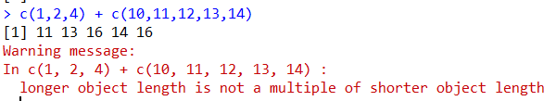
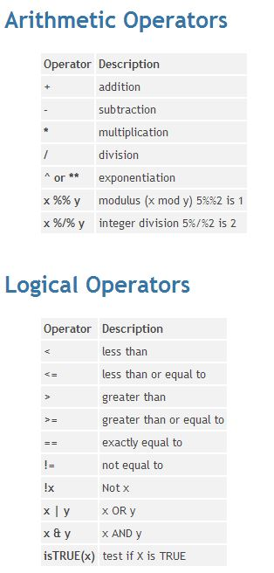
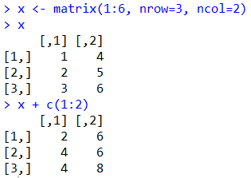
Handling Vectors
Vector reuse
When R conduct an operation with two vectors, the shorter vector is reused to avoid an error
Column-first

Slide 14
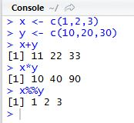
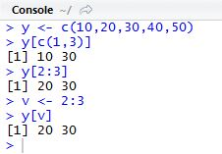

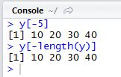
Handling Vectors
Vector operations are element-wise
Vector indexing
Extract a subset of vectors
Index can be used redundantly
A negative index is used to remove the corresponding element

Slide 15
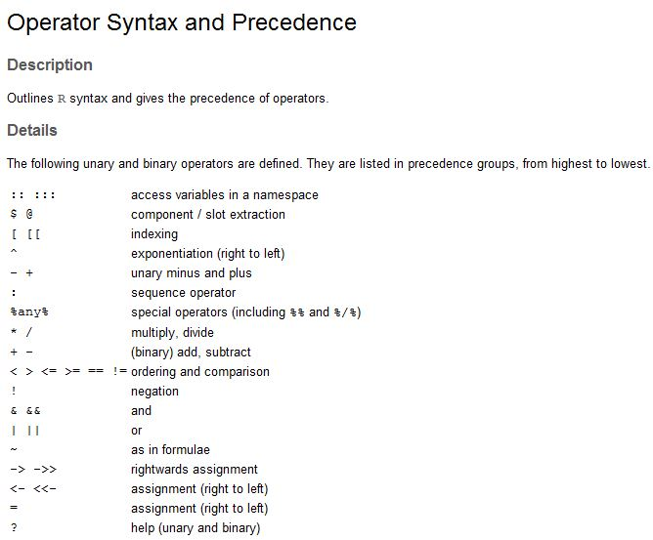
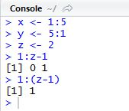
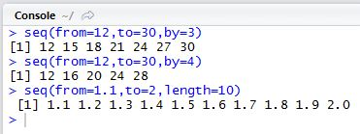
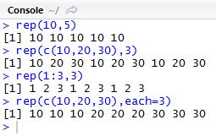
Handling Vectors
Creating vectors with operators
: operator: create vectors with certain range
seq: a generalized version of “:” operator
rep: repeat values

Slide 16
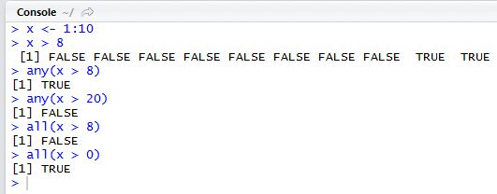
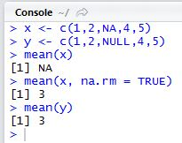
Handling Vectors
Apply conditions for each element in a vector
any() function: return TRUE if at least one of the elements satisfies the condiditon
all() function: return TRUE only when all elements satisfy the condition
NA vs NULL
NA (Not Available): Some value exists but we cannot exactly know the value
NULL: Physically not exist

Slide 17
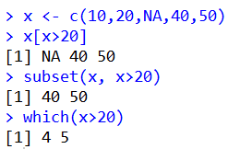
Handling Vectors
Filtering: Extract the element that satisfy a given condition
Directly extract from index
subset(): return the values that satisfy the condition
which(): return the indices that satisfy the condition

Slide 18
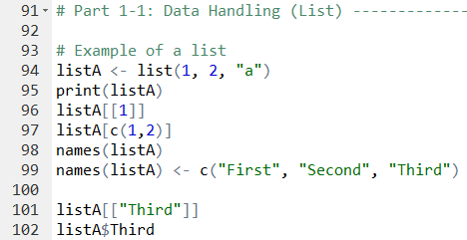
Handling List
Scalar
Vector
List
Matrix
Array
Factor
Data.frame
Lists are heterogeneous
Element in a list can have different modes
List can have other structured object such as dataframe as its element
Elements in a list are referred by their index
Elements in a list can have their names

Slide 19
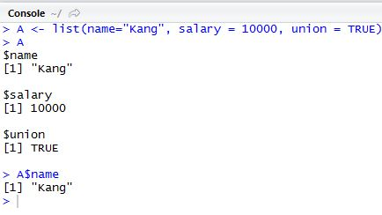
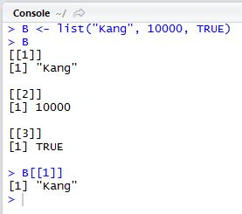
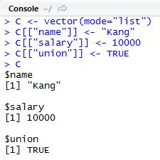
Handling List
Creating a list
Use list() or vector() function
Element names can be assigned using tags

Slide 20
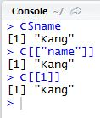
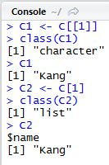
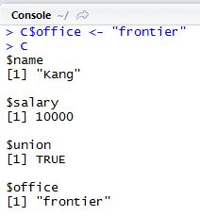
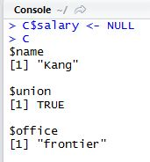
Handling List
List operations
List indexing
Three ways of accessing the elements in a list
list$element_name, list[[“element_name”]], list[[element’s index]]
A list is returned if [ ] is used
Add/remove element in a list
Add: use a new name
Remove: use NULL

Slide 21
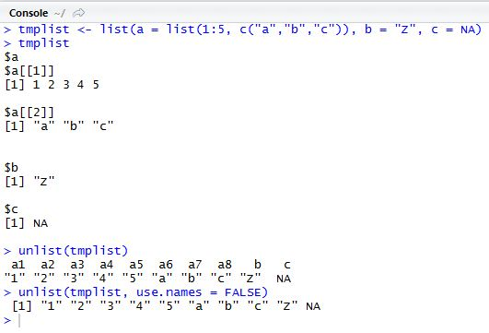
Handling List
List operations (cont’)
Unlist returns a vector with a single mode values

Slide 22
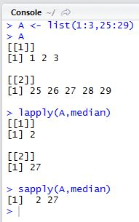
Handling List
Applying functions to list
lapply( ) returns a list while sapply( ) returns a vector

Slide 23
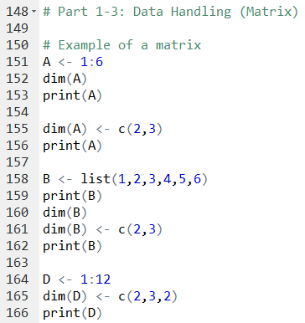
Handling Matrix and Array
Scalar
Vector
List
Matrix
Array
Factor
Data.frame
Matrix
Matrix is a vector with dimensions
Vectors and lists can be transformed into a matrix
Array
Matrix can be extended to n-dimensions
Indexed by multiple locations and returns subvectors

Slide 24
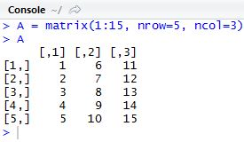
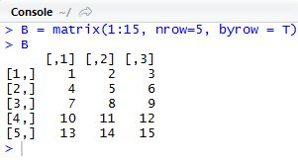
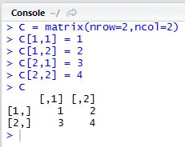
Handling Matrix and Array
Features of matrix in R
Index begins with 1 (0 for python)
Column-major order
Create a matrix: matrix( )
Method 1: provide all elements and assign the number of columns and rows (column first)
Method 2: provide all elements and assign the number of columns and rows (use row first option)
Method 3: Create an empty matrix and fill each element in

Slide 25
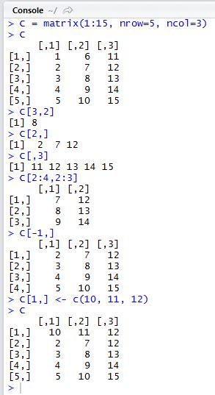
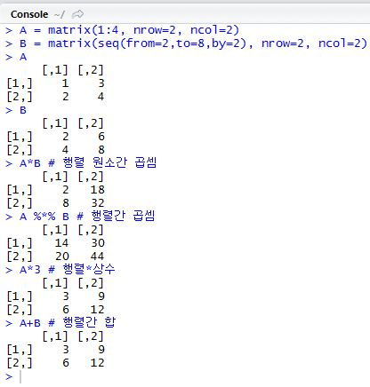
Handling Matrix and Array
Matrix operations
Linear algebra of matrix: matrix multiplication, matrix-constant multiplication, etc.
Indexing and filtering

Slide 26
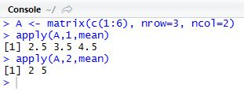
Handling Matrix and Array
Applying functions to the rows/columns of matrix
Use apply( ) function family: apply( ), sapply( ), tapply( ), lapply( ), etc.
apply(m, dimcode, f, fargs)
m: matrix
dimcode: dimension to apply (1: row, 2: column)
f: function
fargs: arguments needed to execute f

Slide 27
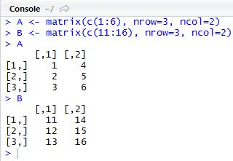
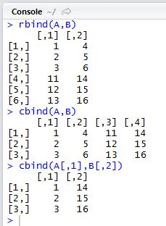
Handling Matrix and Array
Modifying matrix
rbind( ) & cbind( ): combine two matrices
rbind( ): combine two matrices with the same column names (top and bottom)
cbind( ): combine two matrices with the same row names (left and right)

Slide 28
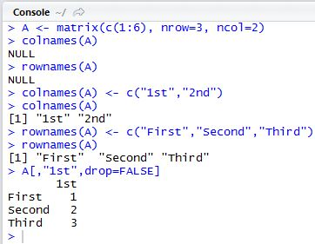
Handling Matrix and Array
Assign names for matrix columns/rows
Use colnames( ) and rownames( )

Slide 29
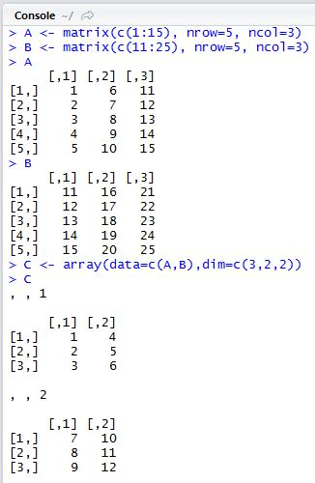
Handling Matrix and Array
High dimensional array
Use array( ) function

Slide 30
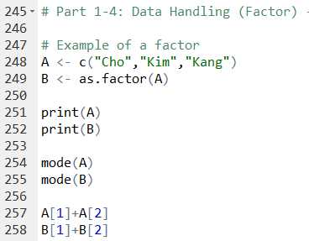
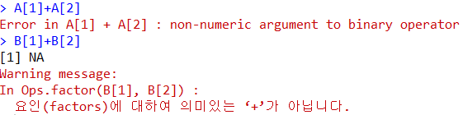
Handling Factor
Scalar
Vector
List
Matrix
Array
Factor
Data.frame
Factor
Vector representation for nominal/categorical variables
Factor has its levels that are equivalent the number of possible values
Usage
Categorical variable representation: 1 level for 1 category
Grouping and tagging
Factor levels must be consistent!

Slide 31
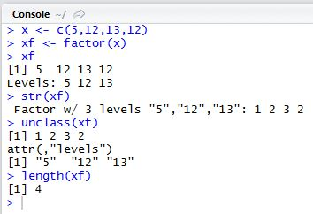
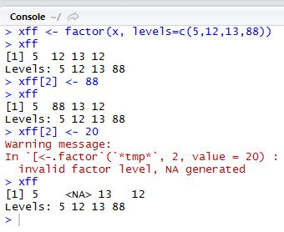
Handling Factor
Factor
Factor in R is a vector with additional information
Additional information is a set of non-redundant values called level
The length of a factor is the number of elements, not levels
Possible to add a new level
A new value with non-existing level is considered as NA

Slide 32
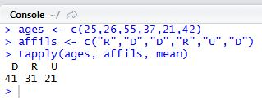

Handling Factor
Applying function to a factor
tapply( )
Useful to make frequency table with different categories
Can be used to more than two factors

Slide 33

Handling Factor
Applying function to a factor
split( ) function
Used to make groups
can be used to more than two factors

Slide 34

Handling Dataframe
Scalar
Vector
List
Matrix
Array
Factor
Data.frame
Dataframe
A table with rows and columns
Regarded as a special case of list
Can have different modes for different columns
Elements in a column must have the same modes
Columns can have names

Slide 35


Handling Dataframe
Creating and accessing Dataframe
Use data.frame( ) function to create a dataframe
Three ways to access a certain element

Slide 36


Handling Dataframe
Extracting and filtering a subset of dataframe
Same as matrix
Combine dataframe
Same as matrix

Slide 37

Handling Dataframe
Merge dataframes
If there are more than on sources of data tables in a database
Inner/outer/left/right joins are possible

Slide 38


Handling Dataframe
Merge dataframes
If different data frames have different column name strategy, explicitly state the column names to use

Slide 39
AGENDA
01
Handling Different Data Types
02
String Processing

Slide 40


String Processing
The length of a string
Use nchar( ) function instead of length( )
Space and special characters can be counted as well
Concatenate strings
Use paste( ) function
Various spacing strategies can be used
Non-character values are also possible

Slide 41

String Processing
Extract sub-strings
Use substring(string, start, end) function
Extract the substring that begins with “start” and ends with “end”
If the string argument is a vector, the other options are applied to all elements

Slide 42


String Processing
Split text
Use strsplit(string, separator) function
A simple string or regular expression can be used as a separator
Ex: split the file path using “/” as a separator

Slide 43


String Processing
Regular expression
a sequence of characters that define a search pattern
this pattern is then used by string searching algorithms
Regular expression in R

Slide 44

String Processing
Regular expression
From: wikipedia

Slide 45


String Processing
Substitution
Use sub(old, new, string) or gsub(old, new, string) functions
sub( ) replaces the first substring whereas gsub( ) replaces all substrings
String pattern matching
Use grep(pattern, x) function
Return the index that matches pattern

Slide 46


Slide 47


References
R Datamining
http://www.rdatamining.com

Slide 48

References
R Bloggers
http://r-bloggers.com

